Slide 1
Troubleshooting

Slide 2
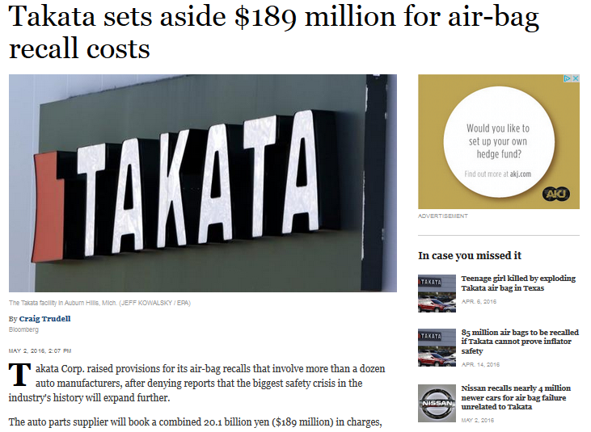

Slide 3
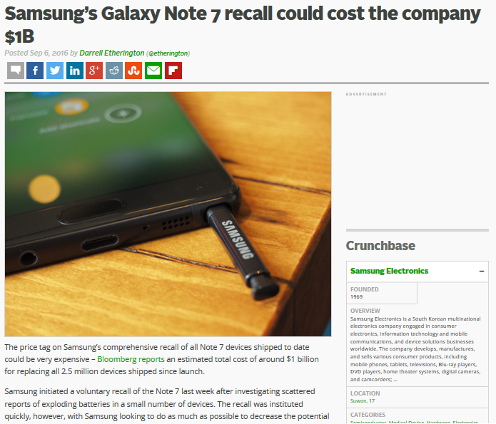
40 miljoen kinderen vaccinaties…

Slide 4
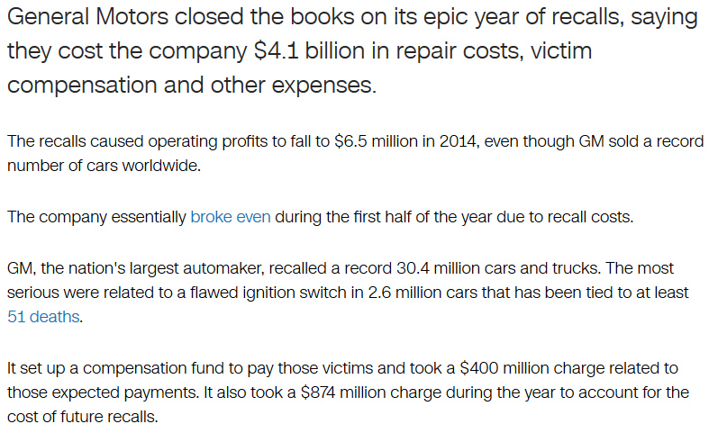

Slide 5
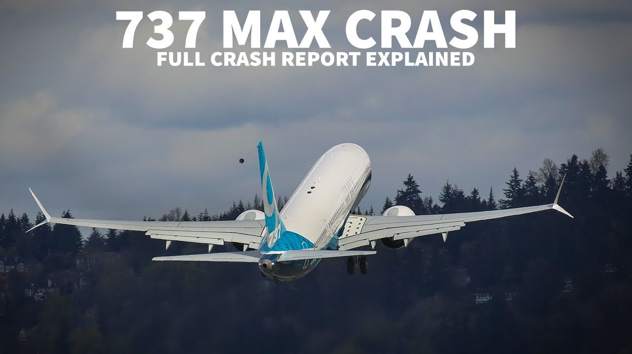

Slide 6
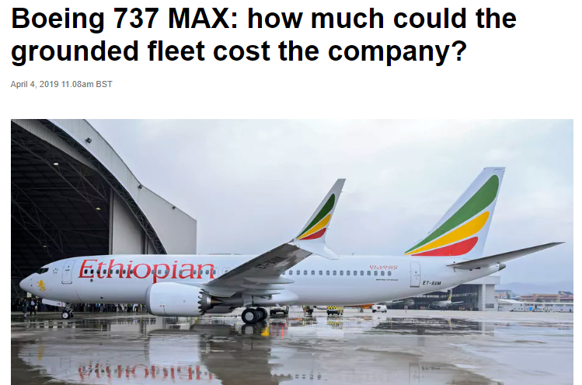
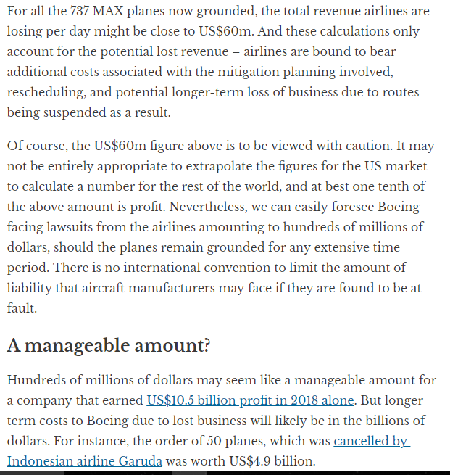

Slide 7
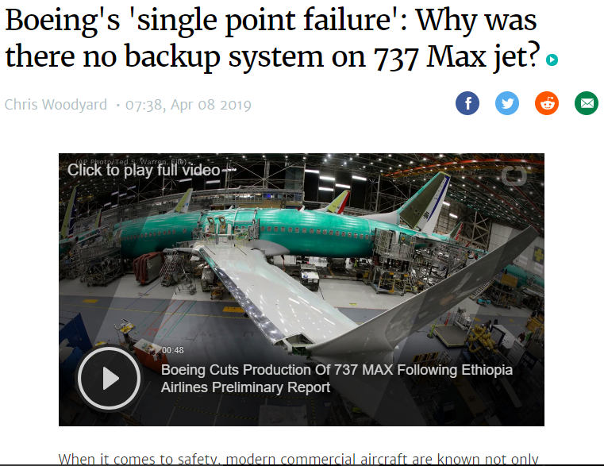
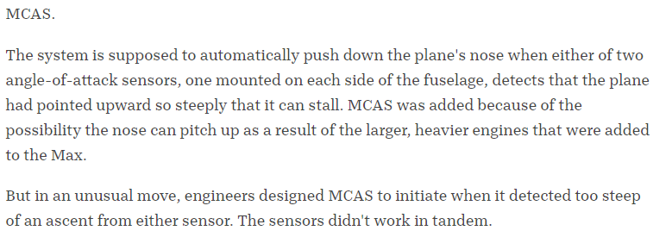

Slide 8


Slide 9
Error Cost Escalation Through the Project Life Cycle - NASA

Slide 10
Error Cost Escalation Through the Project Life Cycle - NASA

Slide 11
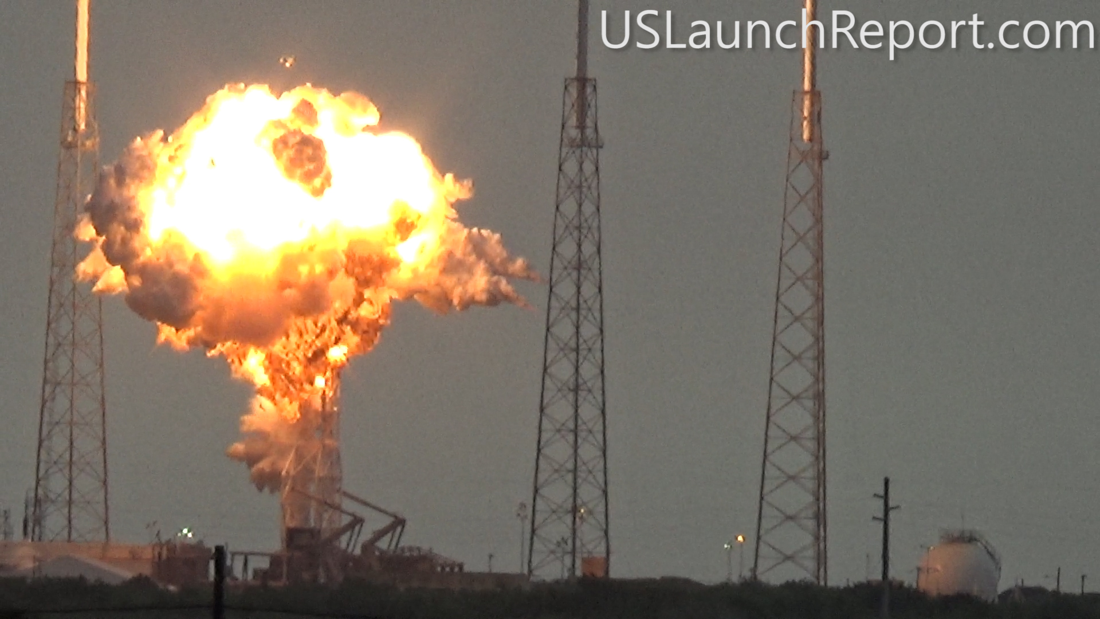

Slide 12
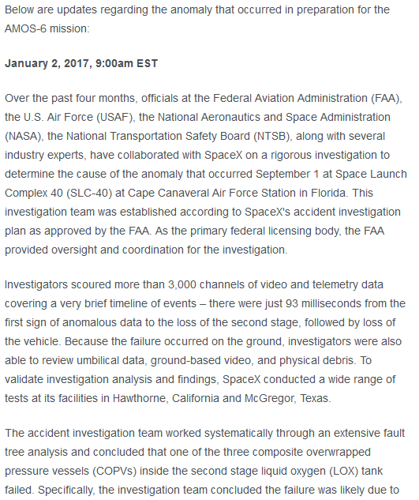

Slide 13
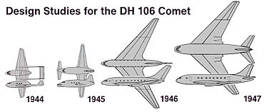
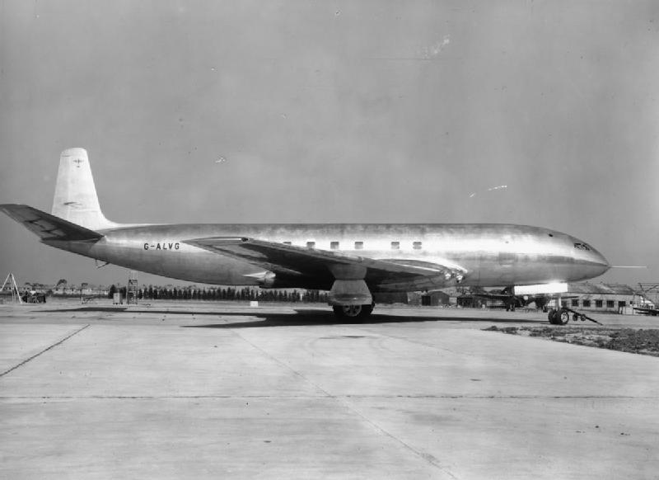
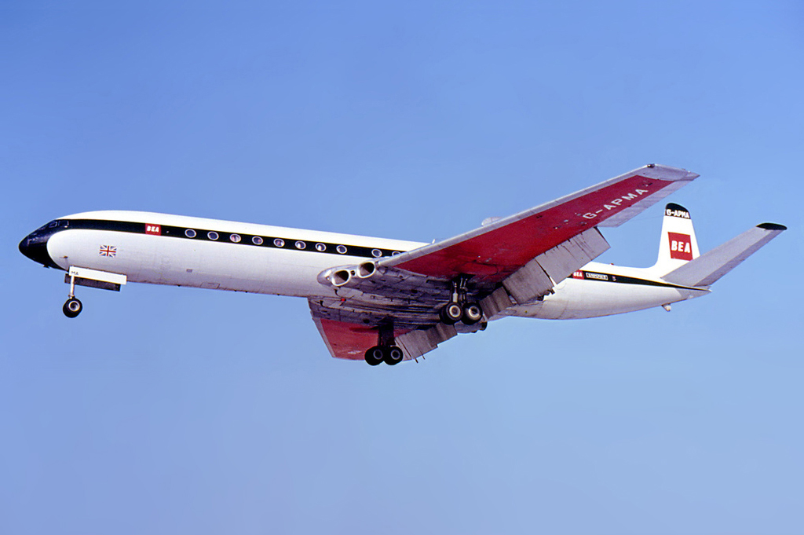
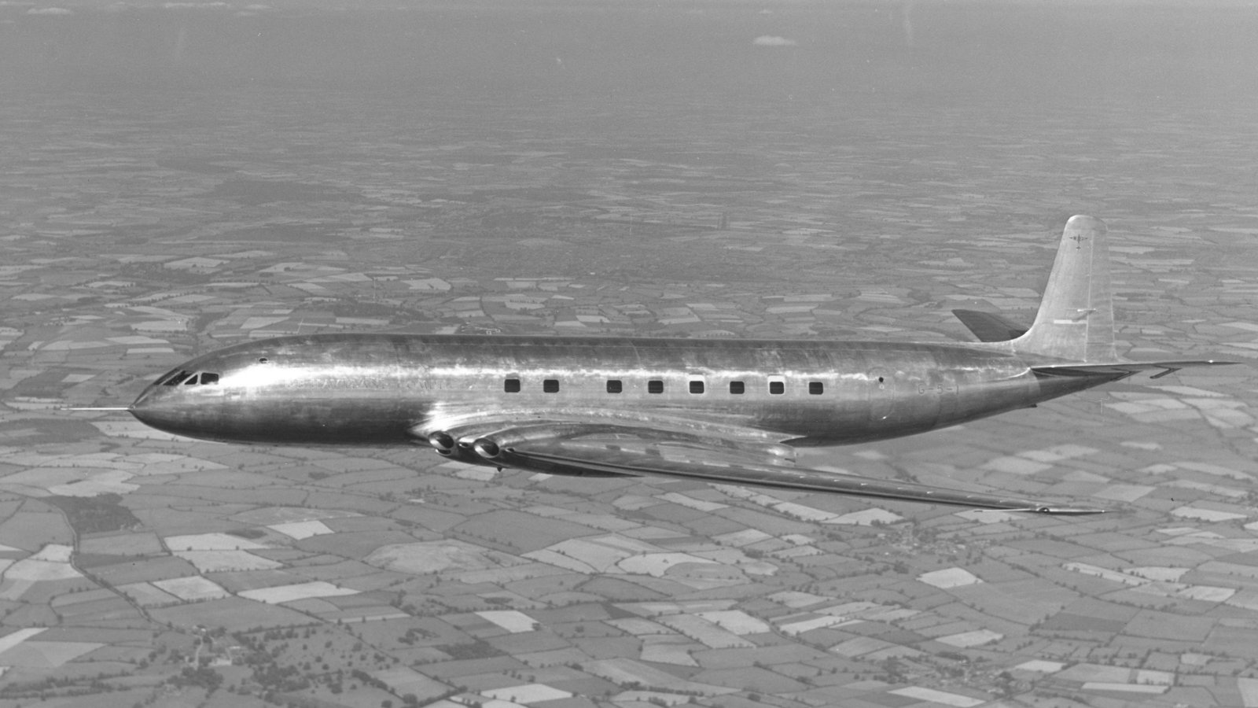
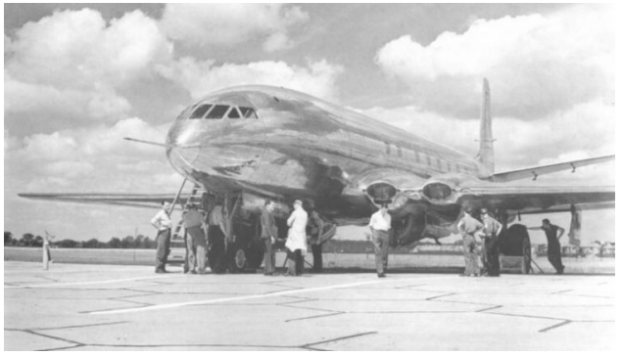
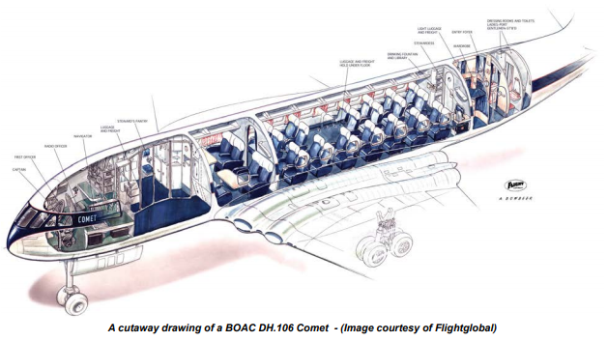
Da Havilland Comet
Three fatal Comet 1 crashes due to structural problems, specifically BOAC Flight 783 on 2 May 1953, BOAC Flight 781 on 10 January 1954, and South African Airways Flight 201 on 8 April 1954, led to the grounding of the entire Comet fleet. After design modifications were implemented, Comet services resumed in 1958.^{[82]}
Although commercial sales for the design never fully recovered, the redesigned Comet Mark 2, Mark 3 and Mark 4 series designs enjoyed a productive career of over the next 30 years.

Slide 14
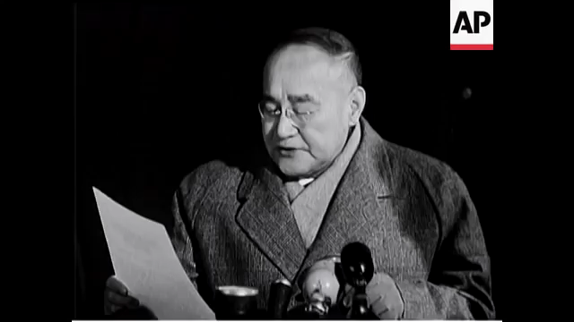
However, within a year of entering airline service, problems started to emerge, with three Comets lost within twelve months in highly publicised accidents, after suffering catastrophic in-flight break-ups. Two of these were found to be caused by structural failure resulting from metal fatigue in the airframe, a phenomenon not fully understood at the time. The other one was due to overstressing of the airframe during flight through severe weather. The Comet was withdrawn from service and extensively tested. Design and construction flaws, including improper riveting and dangerous concentrations of stress around some of the square windows, were ultimately identified. As a result, the Comet was extensively redesigned, with oval windows, structural reinforcements and other changes. Rival manufacturers meanwhile heeded the lessons learned from the Comet while developing their own aircraft.

Slide 15

Troubleshooting
uitzoomen/pauze nemen
Isoleren
(waar zit het?)
History?
Brainstorming
Oorzaak of gevolg?
Segmenteren
(onder welke omstandigheden?)
Assumptions
(moeder van?)
Dubbele fout
Swaptronics
Binnen specs?
Tools?
Echte rootcause?
Test cases/testen!
(meten is weten)
Documenteren
(van testresultaten)
Literatuur?
Berekeningen

Slide 16
List of sunken nuclear submarines
USS Thresher, 1963, 129 dead
USS Scorpion,1968, 99 dead
K-8:, 1970, 60 dead
K-429: 1983, 16 dead
K-219: ,1986, 6+ dead
K-278 Komsomolets: 1989, 42 dead
K-141 Kursk: 2000, 118 dead
K-159: 2003, 9 dead
?
https://en.wikipedia.org/wiki/SUBSAFE

Slide 17
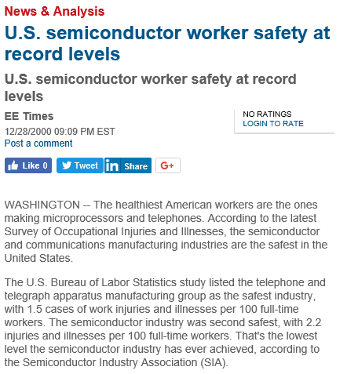
WHY????

Slide 18
Safety/reliability - tooling
1 pager 5 Whys 6 sigma Accelerated life testing Analysis of variance Brainstorming Cause & effects diagram (also known as fishbone or Ishikawa diagram) Control chart Correlation CTQ tree Design of experiments Failure mode and effects analysis (FMEA) Fault tree analysis Histograms | Pareto analysis Pareto chart Regression analysis Root cause analysis Run charts Scatter diagram Taguchi methods …. …. … many more….

Slide 19
Segmentation

Slide 28
Printing/logging
Debuggers
Pin high/low! -> oscilloscope

Slide 30
x=3;
y=5;

Slide 31
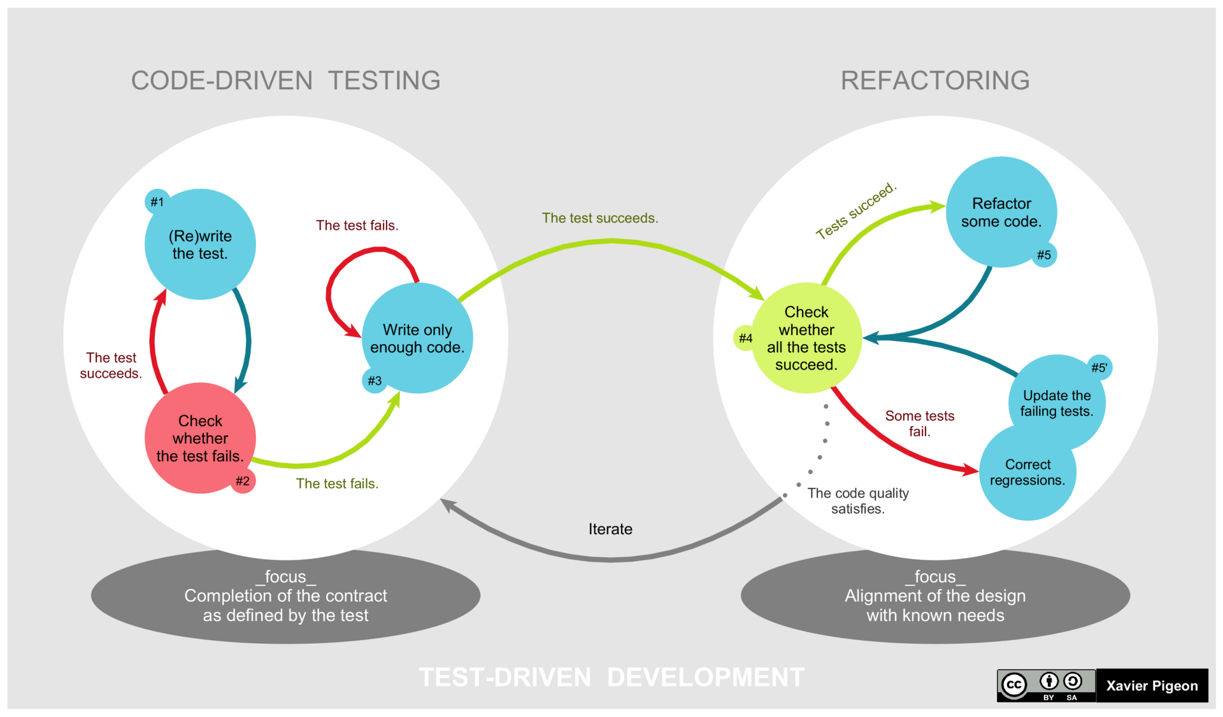
Test-driving development
https://en.wikipedia.org/wiki/Test-driven_development
https://www.guru99.com/test-driven-development.html

Slide 32
SW Nasty s.... (stuff)
Memory issues?
RTOS?

Slide 33
Rootcause analyse
A) Describe problem
B) Identify possible causes
C) Evaluate possible causes
D) Confirm true rootcause

Slide 34
A) Describe problem
- State the problem
- Specify the problem
- What/Where/When/Extent (size)
- Is (wat is het probleem)
De I2C clock lijn crashed als de motor aan staat
- Is not (wat is niet het probleem)
Hij crashed niet als de motor separaat gevoed wordt

Slide 35



Communicatie
Stel: een probleem wordt niet snel opgelost
EN
Er wordt niet helder over het probleem gecommuniceerd door het eigenaren team
CLM
Career Limiting Move!
Je baas
De baas van je baas
De klant

Slide 36
Problem Statement:
Helder opgeschreven wat het probleem is (ondubbelzinnig)
Owner / Team / stakeholders:
Wie werken er aan? Wie hebben er belang in?
Current status:
Wat weten we nu al wel?
Wat is de uitkomst van testen, etc?
Success criteria:
Meetbare criteria!
SMART gedefinieerd
1-Pager
A3
8D
Wanneer wordt wat gedaan?
Bv:
Test IV curve motor in wk 12
Test aan acceleratie in wk 13
plans

Slide 37
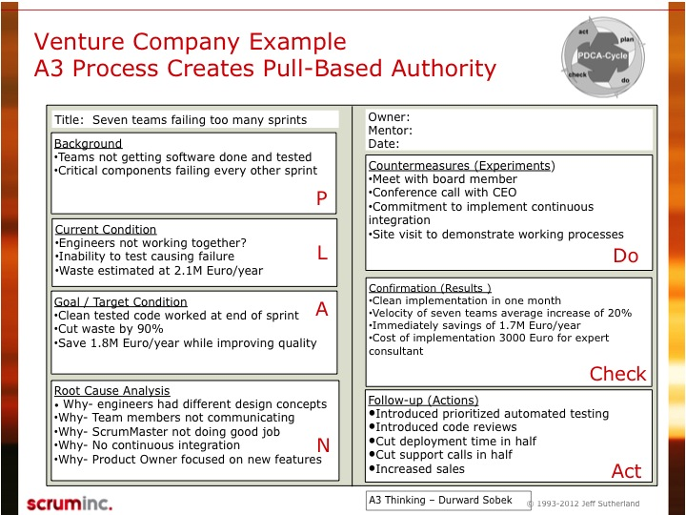
1-Pager
A3
8D

Slide 38
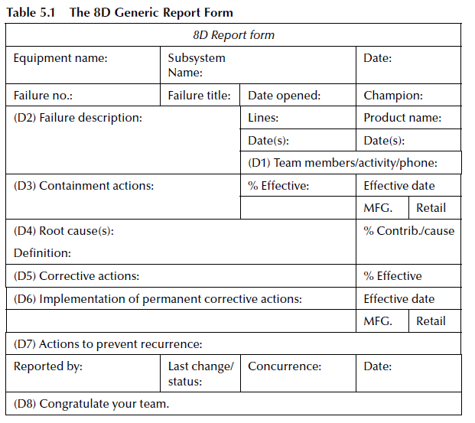
1-Pager
A3
8D

Slide 39

Questions?

